Slide 1

Global Population Trends and Sustainability Forecasting
Platform: Google Colab
Presented by: Sahana Sunddher

Slide 2

Table Of Contents
Introduction
Project Workflow Overview
Dataset Overview
Population Sustainability Score (PSS)
Clustering Based on Growth & Sustainability
Population Forecasting
My Novelty
Future Scope
Conclusion

Slide 3

Introduction
This project aims to analyze and forecast global population trends through data-driven techniques. Using historical population data, we engineered a custom metric called the Population Sustainability Score (PSS) to assess how sustainable each country’s growth is.
We performed clustering to group countries with similar growth and sustainability profiles and applied Polynomial Regression to forecast population trends up to 2040. This approach helps in understanding demographic shifts and identifying countries with potential sustainable growth.

Slide 4

2. Feature Engineering
3. Visualization
1. Data Collection
&
Cleaning
Project Workflow Overview
4. Clustering Analysis
5. Population Forecasting
6. Insights
&
Interpretation

Slide 5
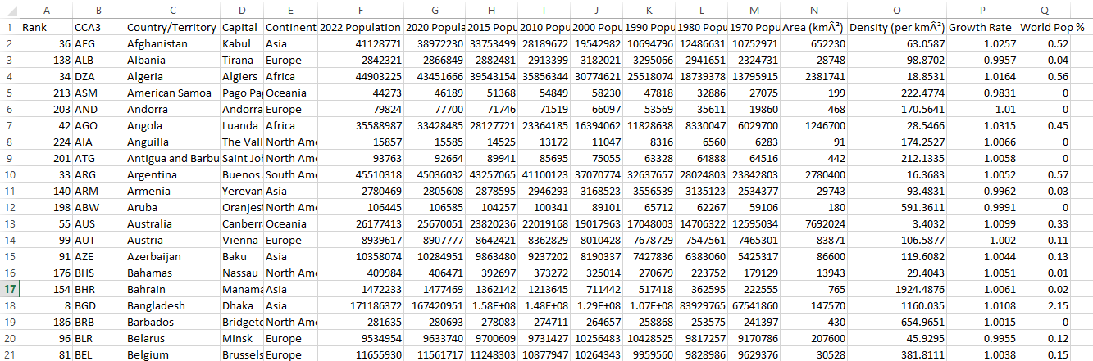
Dataset Overview
Source: Kaggle (World Population Analysis)
Total Records: 200 rows, 14 cities

Slide 6
What is Population Sustainability Score (PSS) ?
The Population Sustainability Score (PSS) is a metric created to measure how sustainable a country's population growth is. It is calculated as:
PSS = Growth Rate / Population Density
Growth Rate: How fast the population is increasing.
Population Density: How many people live in a given area (per km²).
Why It Matters?
High Growth with Low Density: Countries with fast-growing populations but fewer people living in a large area are seen as more sustainable. They have more room to grow without overcrowding.
Low Growth with High Density: Countries with slow population growth but high density may face sustainability challenges like resource scarcity or overcrowding.

Slide 7
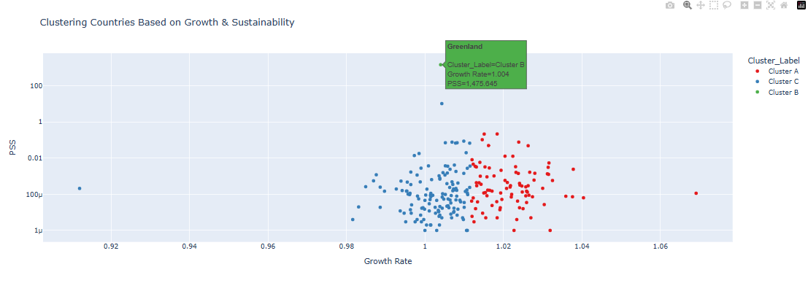
Clustering Based on Growth & Sustainability
Applied KMeans clustering using:
Features: Growth Rate and PSS 2. Number of clusters chosen: [e.g., 3]
Cluster Distribution: Number of countries per cluster (Visualized clusters using scatter plot)
Insights:
Cluster 0: Low growth, low PSS (e.g., aging or saturated populations)
Cluster 1: Balanced
Cluster 2: High growth, high PSS

Slide 8
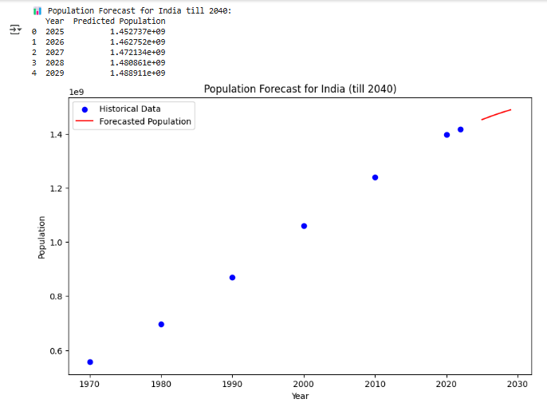
Population Forecasting
Example: India
Plot: Historical vs Predicted
Insights: Growth pattern, potential implications

Slide 9


My Novelty
Future Scope
New Metric: Created the Population Sustainability Score (PSS) using growth rate and population density.
Cluster Analysis: Grouped countries based on both growth and sustainability, not just population size.
Forecasting: Used Polynomial Regression for more accurate long-term population predictions.
Comprehensive Insights: Combined clustering and forecasting for a deeper understanding of global trends.
Add More Factors: Include GDP, healthcare, and education to improve sustainability scores.
Advanced Forecasting: Try models like ARIMA or LSTM for better predictions.
Real-time Data: Use live data for up-to-date forecasting.
Interactive Dashboard: Create a dashboard to visualize trends and forecasts easily.

Slide 10
Conclusion
My project successfully analyzed global population trends, focusing on sustainability and growth patterns. By introducing the Population Sustainability Score (PSS), were able to assess and compare countries based on their growth and density in a more meaningful way.
Through clustering, I identified different groups of countries with similar population dynamics, providing valuable insights into their sustainability. The Polynomial Regression model enabled us to forecast future population trends, giving us a glimpse into potential demographic changes up to 2040.
Overall, my project demonstrates the power of data analysis in understanding global trends and offers a foundation for future work in demographic forecasting and sustainability planning.

Slide 11

Thank You

